Slide 1
Improving urban flood detection Project Update
Katy Sill
April 24th, 2019

Slide 2
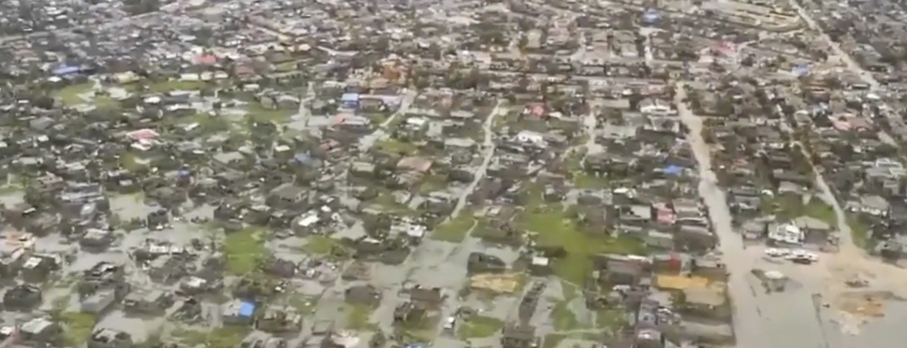
Urban Flooding
Floods account for 43% of natural disasters in last 20 years
Climate change is expected to result in increased flooding events
By 2005, the urban population is expected to grow by 2.5 billion people, with 90% of this growth is predicted to take place in Africa and Asia

Slide 3
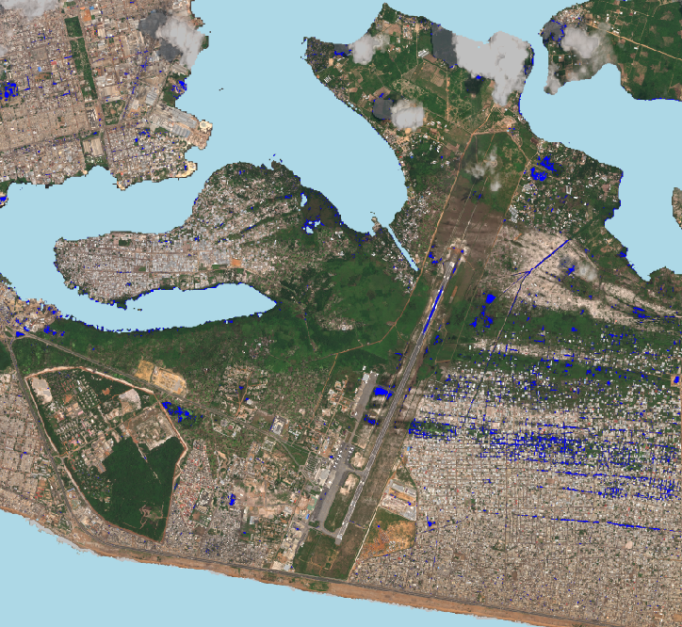
Cloud to Street
High-resolution maps of flood-prone areas for:
planners
insurers
disaster response agencies..
To better:
prepare for floods
respond to flood events in near real-time
understand and price flood risk
insure vulnerable populations
Notes:
Millions of people in cities are affected by flooding events each year. Cloud to Street, my partner for this project, uses satellite imagery to make high resolution maps for flood prone areas in low and middle income countries. These maps are designed to enable decision makers the best information possible to prepare and respond to flooding events, to better understand and price flood risk

Slide 4
Urban flood map challenges
NDWI does not work well in urban settings due to interferences from the built environment
High resolution imagery does not include the required SWIR band to calculate MNDWI
Attempts at using a combination of indices and bands may fall short of mapping the true flooding extent
Building shadows look visually similar to flood waters and can be misidentified

Slide 5
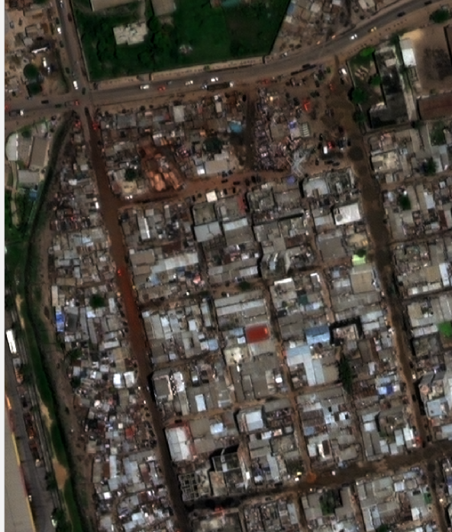
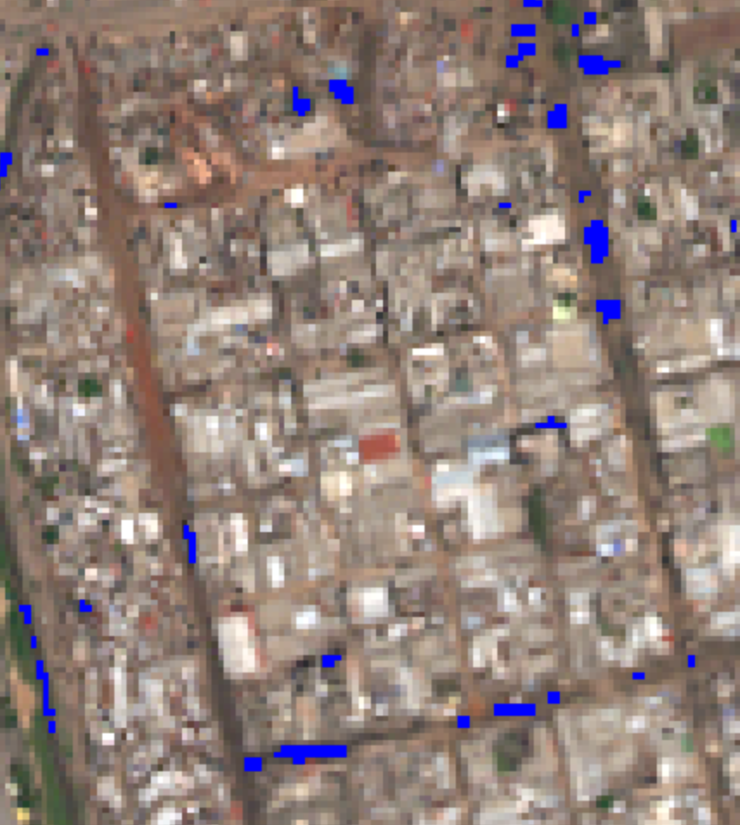
Current flood map issues
Areas of flood not captured by flood map
Building shadow misidentified as flood
WorldView-2
Cloud to Street Flood Map

Slide 6
Project goals
Improve flood detection workflow
Focused on differentiating building shadow and flood waters
Explore open source Python-based tools
Cloud to Street uses Google Earth Engine and is interested in exploring other options
Geographic focus
Abidjan, Ivory Coast
Flooding event from June 2016
Final products
A report of the different potential options explored for improving the workflow
A final workflow to create an improved flood extent map for Abidjan (and potentially other cities*)
Academic paper (?)

Slide 7
Flood Detection Project Approach
Explore imagery and
select area of interest
Calculate spectral and
morphological indices
Create reference dataset
60% for model development
40% for model validation
Threshold spectral and morphological indices
Train/test supervised machine learning model
- Support Vector Machine
Develop unsupervised machine learning model
Kmeans
Gaussian mixture model
Compare outputs to reference dataset
Iterate to improve models where possible
Validate final models using validation dataset
Analyze final model outputs
Write analysis report
Select model and finalize proposed workflow
Notes:
This is an overview of the steps needed to complete this project. The orange boxes are tasks I have completed, the yellow is where I am at currently and the green are things I still need to do. Briefly, what I’ve done so far is to explore the flooded image and identified a representative sub-section of the city to focus my analysis. I then started by trying to recreate and improve the algorithm using a similar approach as cloud to street, so basically combining and thresholding spectral indices, adding in new measures which help identify shadow and building footprints. The result so far is mixed.. There is definitely a benefit by adding in shadow – but otherwise it is a bit mixed. I then looked at supervised and unsupervised machine learning models. For supervised I looked support vector machine, or SVM and for unsupervised I have looked at both Kmeans and the Gaussian mixture model, with most of my efforts on kmeans. For SVM, I needed to develop a reference data set for training and testing the model, so I used ArcGIS to drop points on specific areas of the image that identified flood, shadow and other land cover types. So right now I am analyzing the outputs of these three approaches and seeing if I can iterate to make any improvements to the model. Next steps are to validate the final model and

Slide 8
Validation Process
For the development of the SVM map, the reference data set was divided:
60% for training and testing
40% for testing
60% for training
40% for external validation
SVM map was created based the entire image
The Kmeans and thresholding maps were created based on the entire image.
Accuracy scores were calculated for the 60% training/testing dataset, the 40% external dataset and the entire reference dataset.

Slide 9
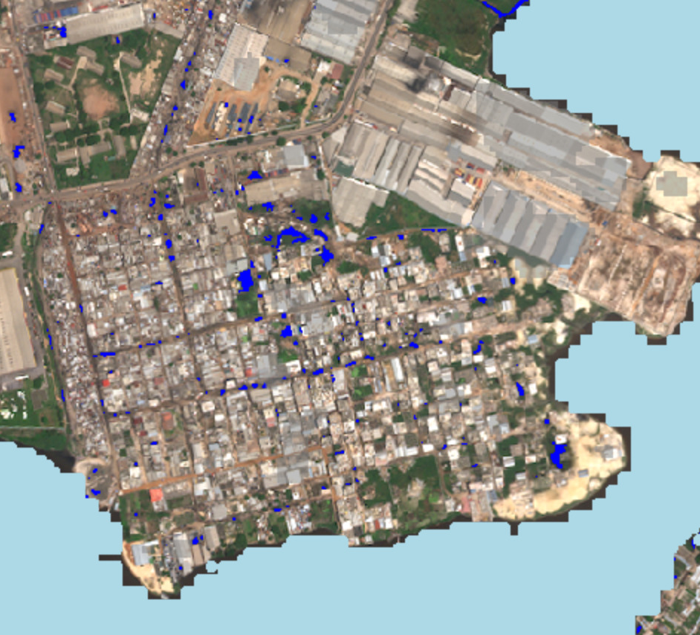
Cloud to Street Abidjan Map
Include algorithm

Slide 10
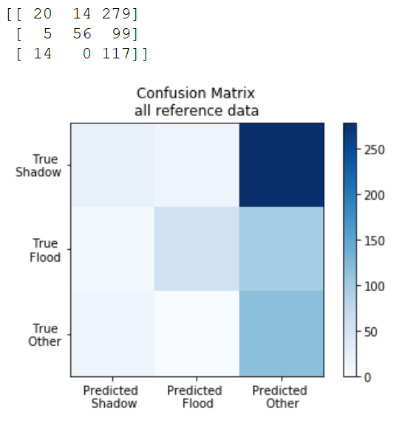
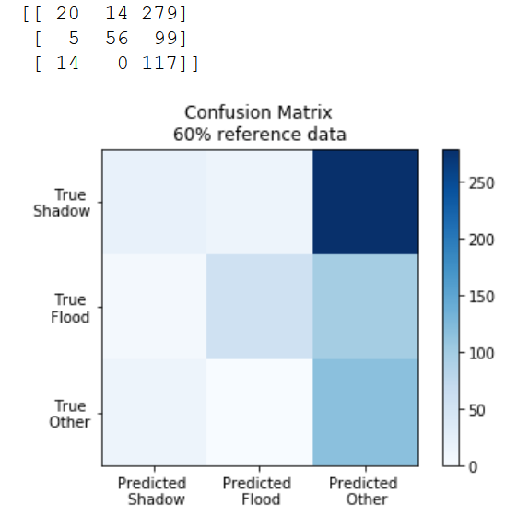
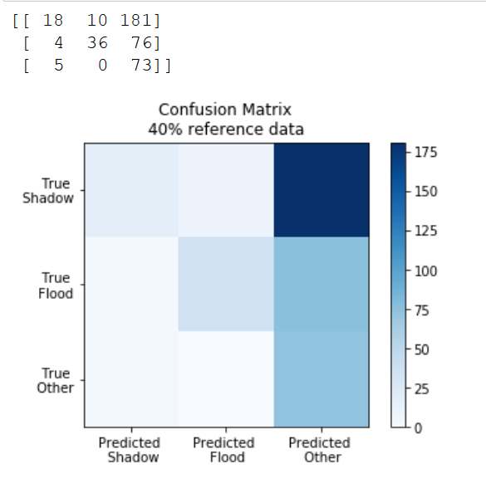
Cloud to Street – All Reference Data (shadow, flood, other)
Accuracy score (60%) = 32%
Accuracy score (40%) = 32%
Accuracy score (all data) = 32%

Slide 11
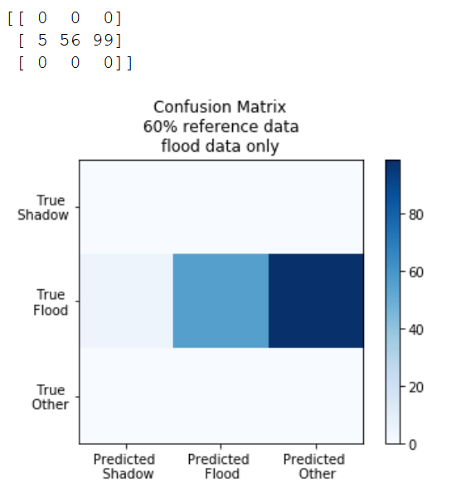
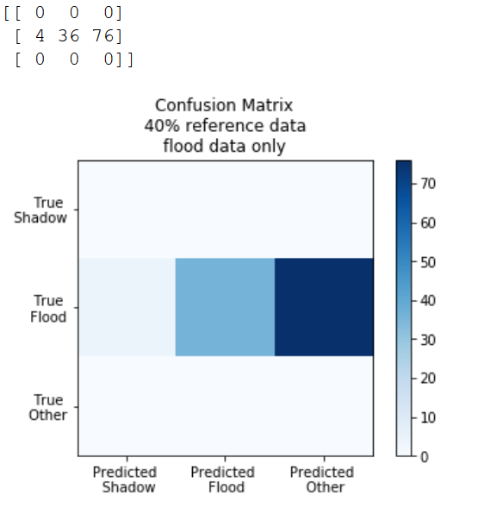
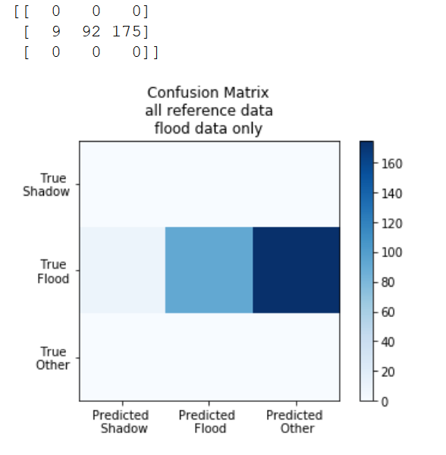
Cloud to Street – Flood Only (flood, other)
Accuracy score (60%) = 35%
Accuracy score (40%) = 31%
Accuracy score (all data) = 33%

Slide 12
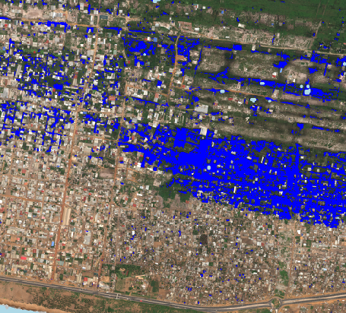
Southeast Cloud to Street Placeholder

Slide 13
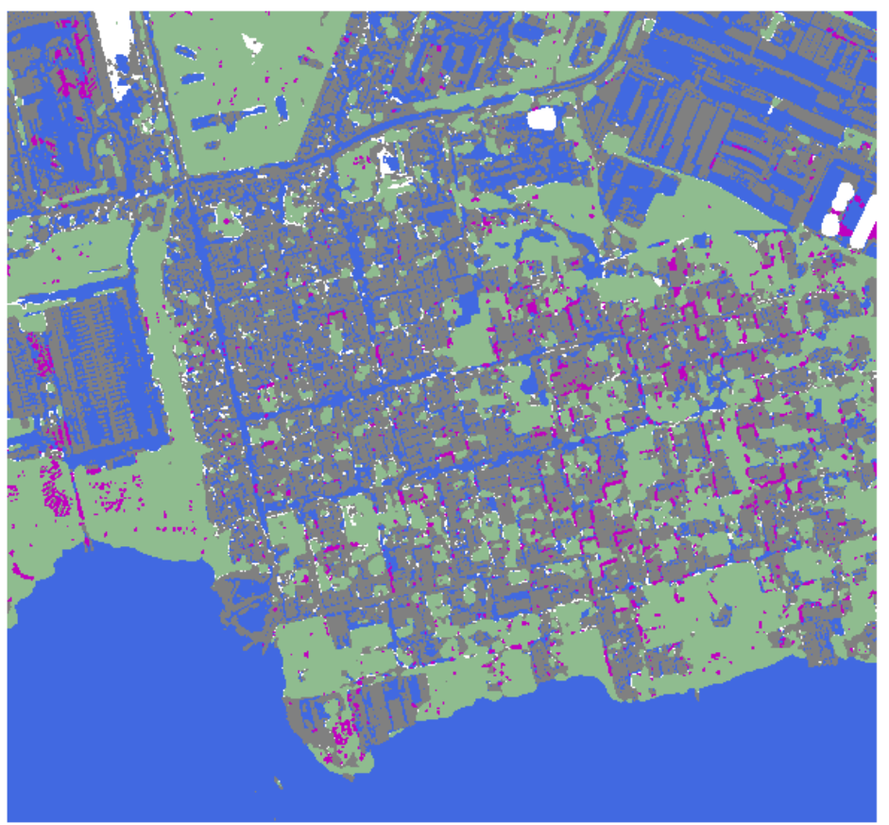
Thresholding Result
Changed representation of flood from Cloud to Street algorithm to just NDWI calculated using yellow_band and near_ir2 (NDWI2)
Increased threshold to
> -0.12
Much improves visualization and accuracy score
ADD LEGEND

Slide 14
Thresholding Challenges/Questions
Explore if MBI can be further improved.. Does not currently appears to add much value.. Still significant building/flood confusion.
Ask Jeff more about the existence of building footprint layers, etc.
Compare “Flood” vs. NDWI2 accuracy scores

Slide 15
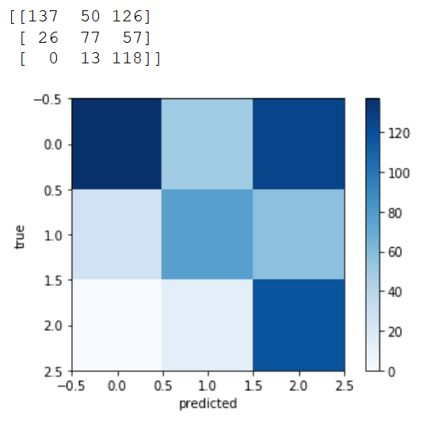
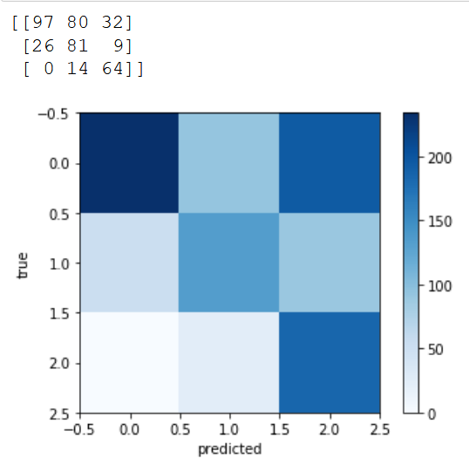
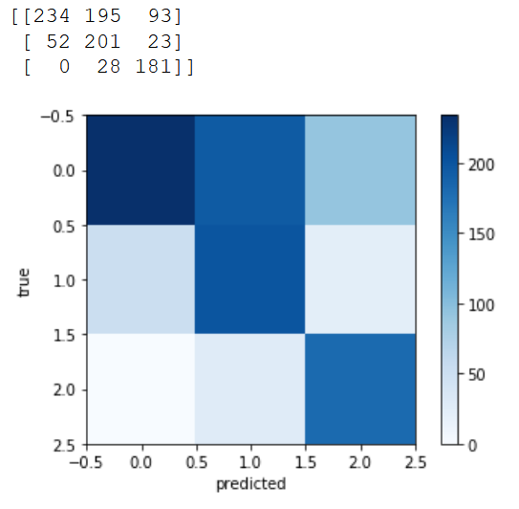
Threshold Map Accuracy Scores and Confusion Matrices
Accuracy score (60%) = 62%
Accuracy score (40%) = 60%
Accuracy score (all data) = 61%

Slide 16

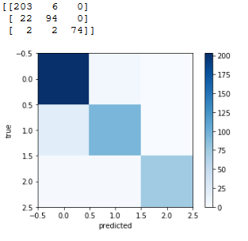
Support Vector Machine (SVM)
Confusion Matrix
Validated model
60% of reference points
40% of reference points
Training data to develop model
Test data to internally validate model
External data to fully validate model
Current 5 inputs include:
- Dark parameter (sum of RE and NIR1&2)
- NDWI – MSI (x2)
- MBI
- MSI
Internal testing accuracy score:
96%
External validation accuracy score:
90%
Challenges/Next steps:
- Make an SVM-based flood map to better
visualize model results
- Conduct sensitivity analysis to
determine ideal model inputs

Slide 17
SVM Sensitivity Analysis
Parameters Included | Accuracy Scores (%)
 | 40% Reference Data (test) | 40% external data
Dark, MBI, MSI, NDWI_coastal – MSI, NDWI_green – MSI | 95.9 | 90.6
Dark, MBI, MSI,NDWI_green, NDWI_yellow, NDWI_coastal – MSI, NDWI_green – MSI, NDWI_yellow – MSI | 93.4 | 91.8

Slide 18
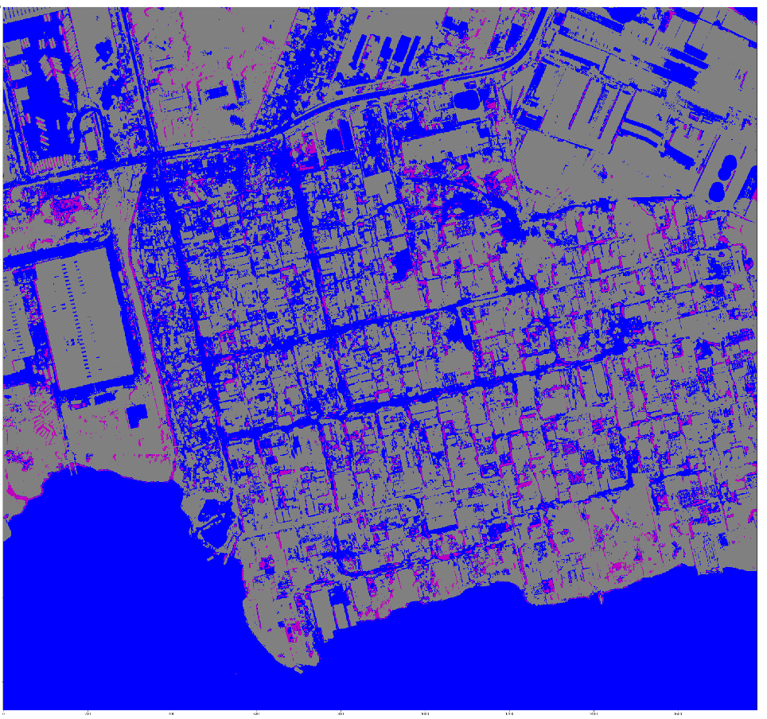
New SVM Resulting Map
Blue – water
Pink – building shadow
Grey – other

Slide 19
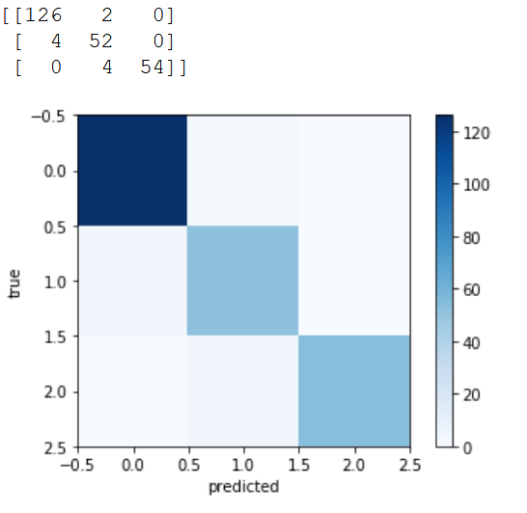
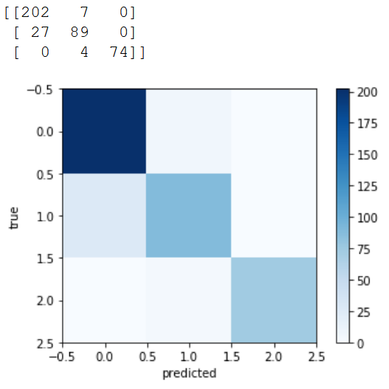
SVM Map Accuracy Scores and Confusion Matrices
Accuracy score (test data)= 95.9%
Accuracy score (external 40%) = 90.6%

Slide 20
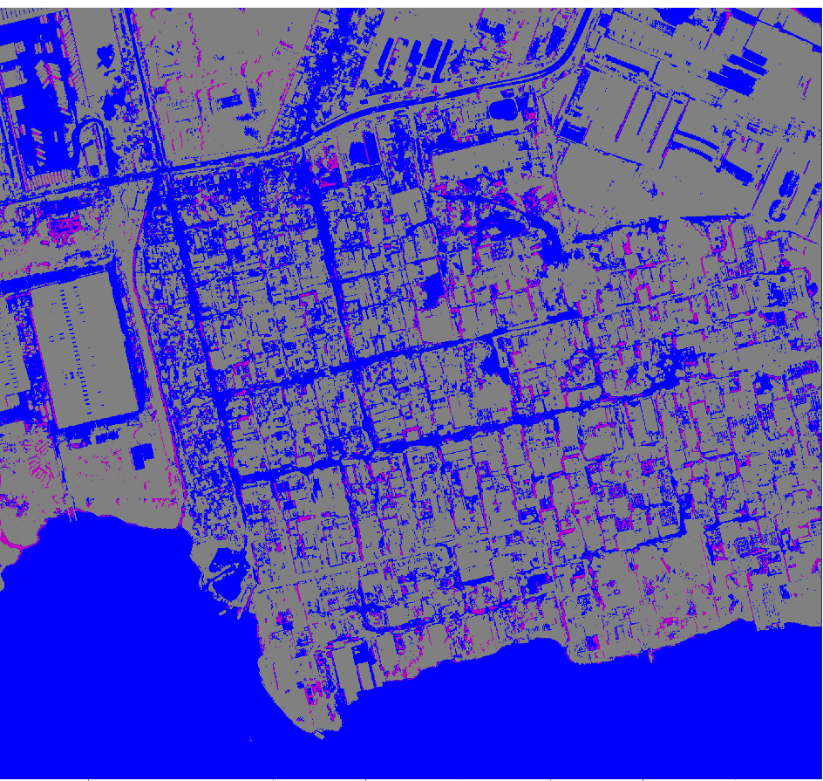
Random Forest Resulting Map
Blue – water
Pink – building shadow
Grey – other

Slide 21
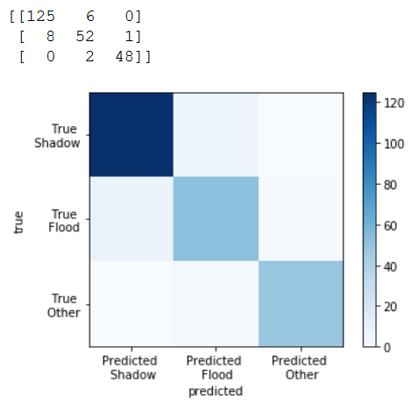
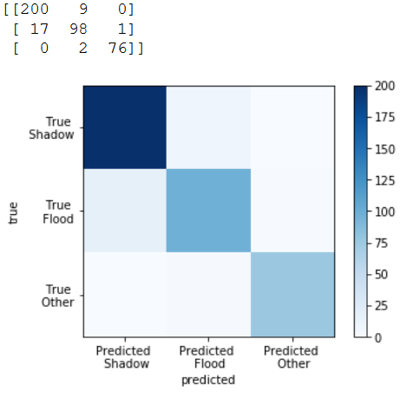
Random Forest Map Accuracy Scores and Confusion Matrices
Accuracy score (test data)= 93%
Accuracy score (external 40%) = 92.8%

Slide 22
SVM Challenges/Questions
Explore other combinations for inclusion for the training dataset.
Consider adding NDWI2 (yellow/NIR2)
Document trials

Slide 23
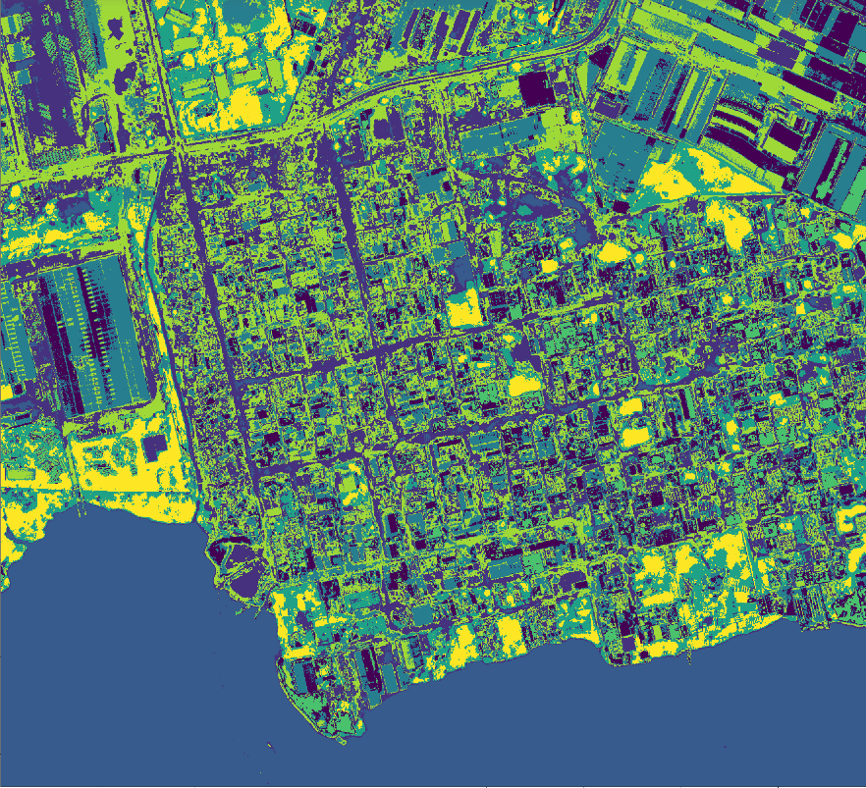
K-means Result
K-means appears to capture shape of floodwaters more accurately

Slide 24
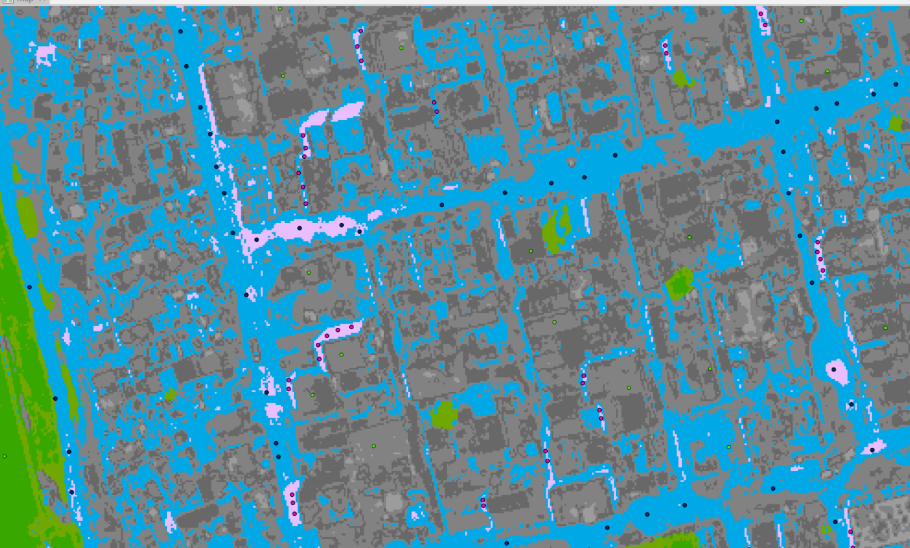
Water and shadow in overlapping clusters
Challenges/Next steps:
Try to refine clusters that include both shadow and water
Try to combine shadow index with K-means
Make sure k-means isn’t over-representing flood
K-means clusters Pink = shadows Blue = water Green = vegetation Grey = buildings
Reference points Pink = shadow Blue = water Green = other

Slide 25
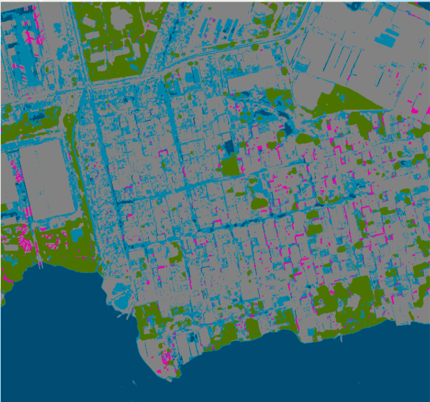
New k-means Result
Includes 8-band stack and shadow_mask
Shadow mask = MSI > 0.12, disk_size = 2
Continue to test accuracy scores on various kmeans efforts.

Slide 26
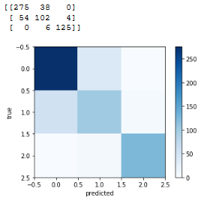
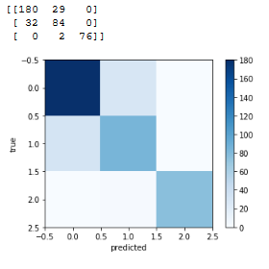
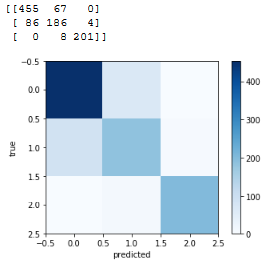
k-means Map Accuracy Scores and Confusion Matrices
Accuracy score (60%) = 83%
Accuracy score (40%) = 84%
Accuracy score (all data) = 84%

Slide 27
Labeled k-means
Final k-means geotiff was labeled using skimage.measure.label()
Region properties were then calculated using regionprops()
Result includes properties for each labeled region
Reviewed properties for clusters containing flood and shadow
Using 60% reference point data set, explored characteristics and moved clusters based on thresholds
Area
Perimeter
Etc.

Slide 28
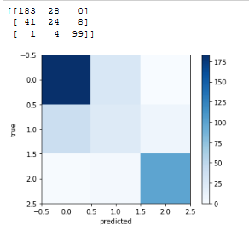
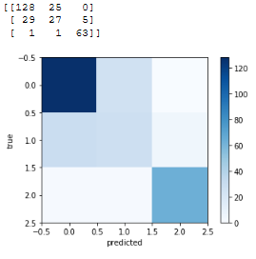
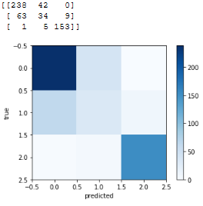
Labeled k-means Map Accuracy Scores and Confusion Matrices
Accuracy score (60%) = 79%
Accuracy score (40%) = 78%
Accuracy score (all data) = 78%
* Can increase accuracy score to ~83% by refining characteristics

Slide 29
k-means Sensitivity Analysis
Kmeans | 40% accuracy | 100% accuracy
kmeans_all_bands | 82.8% | 82.5%
kmeans_cl_free | 82.8% | 82.5%
kmeans_shadow_free | 82.8% | 81.5%
kmeans_shadow_free_shadow_mask | 83.5% | 81.9%
kmeans_with_shadow_free_shadow_masked_texture | 82.4% | 81.0%
kmeans_with_shadow_build_mask | 81.8% | 80.9%
kmeans_cl_free_shadow_mask | 84.1% | 82.3%
kmeans_with_msi | 76.1% | 74.2%
kmeans_with_shadow_free_shadow_masked_texture | 82.4% | 81.0%
kmeans_cl_free_msi | 63.3% | 61.4%
kmeans_shadow_free_msi | 76.1% | 74.0%

Slide 30
k-means Notes
Conducting sensitivity analysis to confirm which kmeans result appears best. Options include:
Regular 8-band stack
Cloud-masked 8-band stack
Building Shadow, cloud-masked 8-band stack
Shadow masked stack plus MSI 9-band stack
Shadow masked stack plus smoothed MSI 9-band stack
Shadow masked stack plus MSI shadow mask 9-band stack
Shadow masked stack plus MSI shadow mask and MBI building mask 10-band stack
So far, most have similar accuracy scores. Including the shadow mask as a layer results in three clusters which include shadow and water, while using the 8-band stacks include only two clusters with water and shadow.
Will make table showing kmeans options with accuracy scores.
Rethink how data is being combined for accuracy score calculations. Currently matching based on label_ID but that results in reference points in the same label_ID region being lost.
Appears to impact flood reference points more than shadow due to continuous nature of flood water labeled regions.
Currently exploring shape characteristics to see if clusters can be refined so that all shadow is in one cluster and all flood is in a separate cluster.
Increased accuracy score of 60% reference dataset to 83%

Slide 31
Challenges/Questions
Potential over-representation of flood waters??
Kmeans
SVM
NDWI2 mask
Overlap between buildings and flood waters
All maps
Could validation be done differently?
Is 1007 reference points enough?
Should I even out the distribution of points?
522 – shadow
276 – water
209 – other
Ask Jeff about more how Cloud to Street algorithms were finalized

Slide 32
Remaining Tasks
Finalize models
Complete final model runs
Analyze validation and accuracy scores
Test model on other location*
Clean up code and finalize workflow
Write report of process and findings

Slide 33
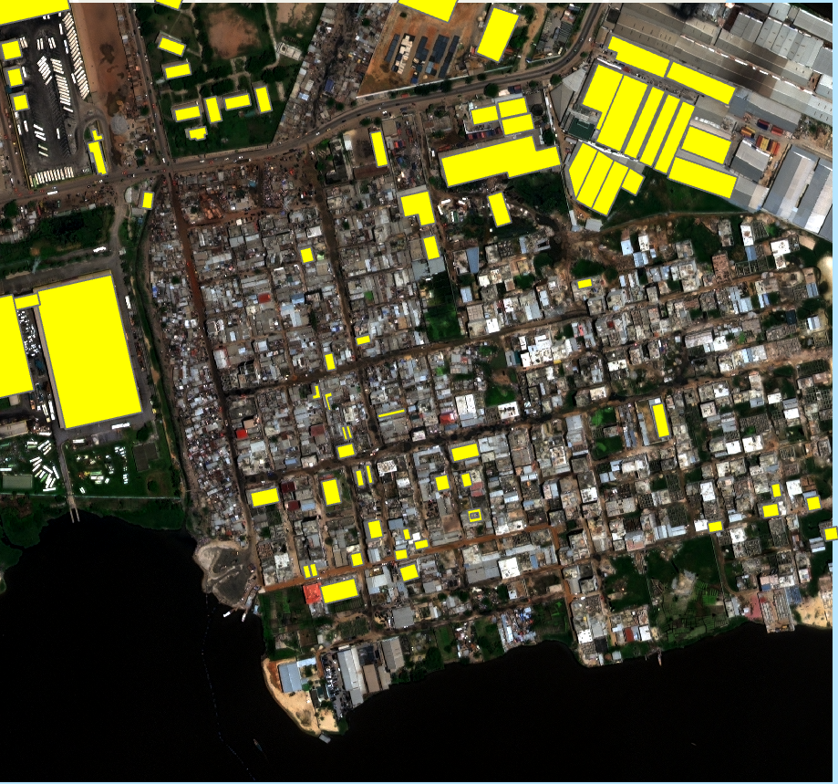
Future Work
Use Open Street Map building layer to more clearly delineate buildings from flood
Currently limited buildings have been identified
Proximity to building could help differentiate
Shape/texture still worth exploring
Apply to entire image
Expand training points to include more vegetation

Slide 34
Steps needed
Cloud mask
Then shadow mask (?)
Can SVM accept shadow masked information?
Could always apply cloud mask afterwards?
Add slide with flood surface area calcs for each method

Slide 35

Questions?
References:
Huang, X., Xie, C., Fang, X., Zhang, L. (2015) Combining Pixel-and Object-Based Machine Learning for Identification of Water-Body Types from Urban High-Resolution Remote-Sensing Imagery. IEEE J. Sel. Top. Appl. Earth Obs. Remote Sens. 8, 2097–2110.
Huang, X., and Zhang, L. (2012) Morphological Building/Shadow Index for Building Extraction From High-Resolution Imagery Over Urban Areas. IEEE J. Sel. Top. Appl. Earth Obs. Remote Sens. 5, 161-172.
Xie, C., Huang, X., Zeng, W., & Fang, X. (2016). A novel water index for urban high-resolution eight-band WorldView-2 imagery. International Journal of Digital Earth, 9(10), 925–941.
Cloud to Street. Urban Flood Mapping Using Very-High Resolution Satellite Imagery. Available at: https://abidjan.cloudtostreet.info/info
Acknowledgements:
Jenny Palomino, CU Earth Lab
Joe McGlinchy, CU Earth Lab
Jeff Ho, Cloud to Street

Slide 37
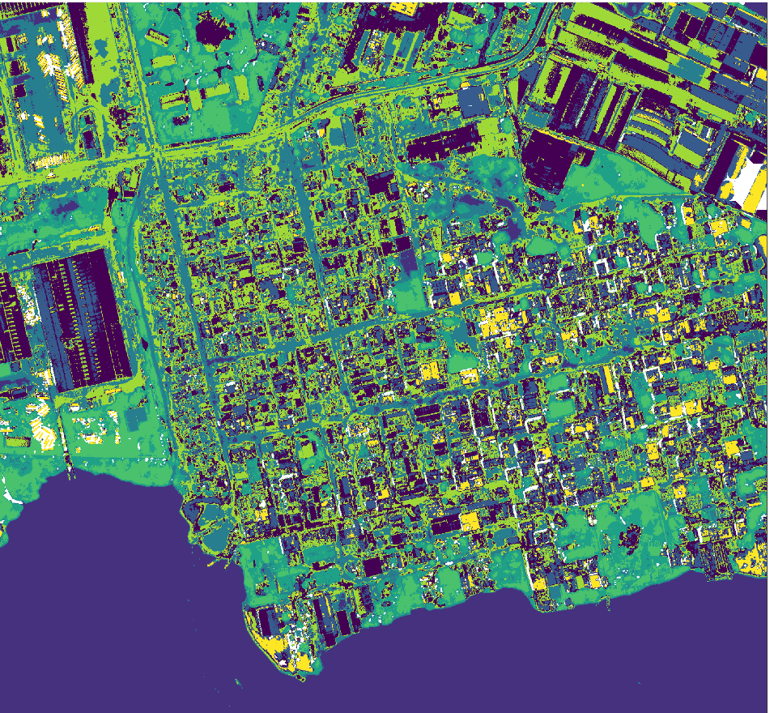
Combining Building Shadow Mask and K-means
Because MSI shadow mask appears to well capture building shadows, a combination of MSI with k-means could be interesting.
Trying to run kmeans on masked data
Apply shadow mask after the fact. Classify remaining clusters as flood, wet soil, etc?
Add MSI as an input for the kmeans calculations

Slide 38
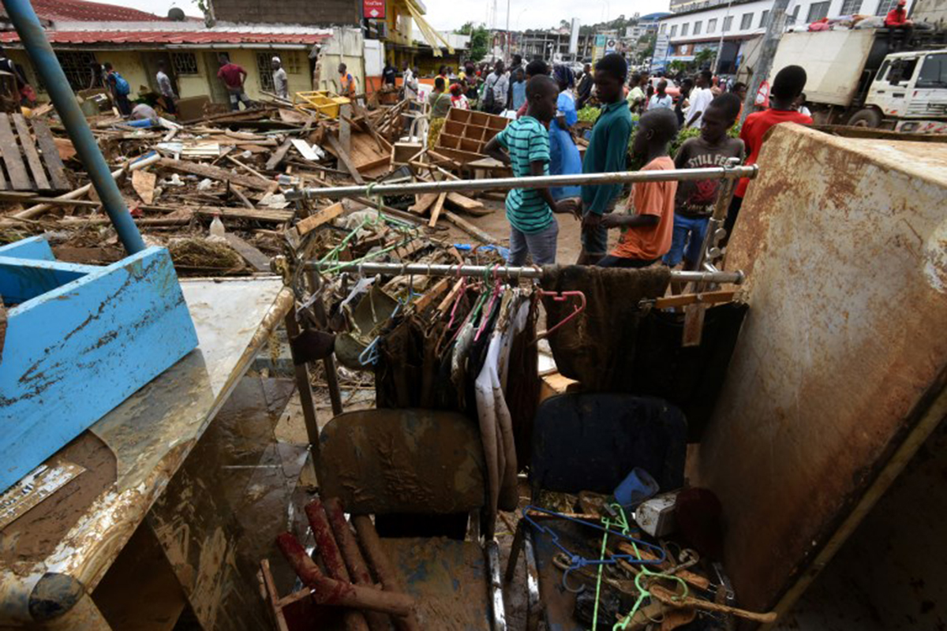
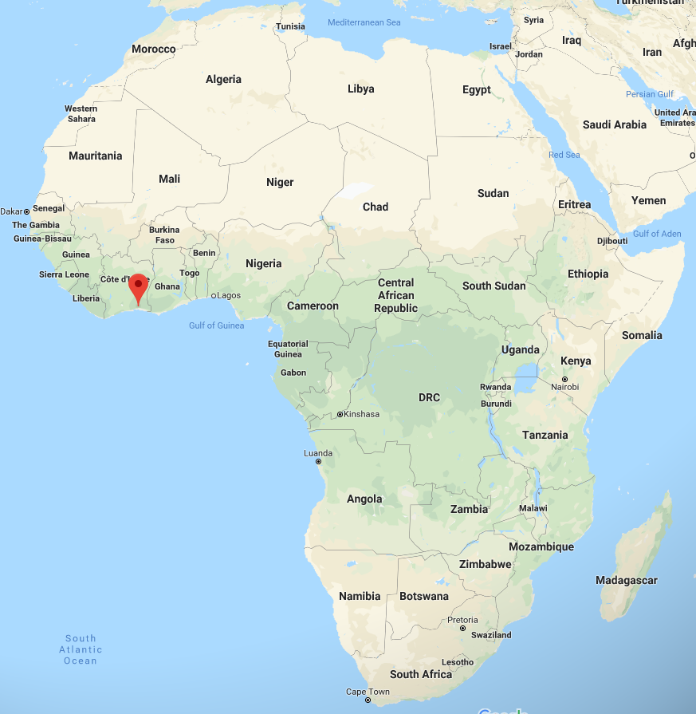
Abidjan, Cote D’Ivoire
5 million people
Francophone West Africa’s largest economy
21 people killed by flash flood in June 2018
X mm of rain fell
136 people rescued
Authorities intend to demolish structures and compensate owners
Notes:
https://reliefweb.int/disaster/fl-2018-000077-civ

Slide 39
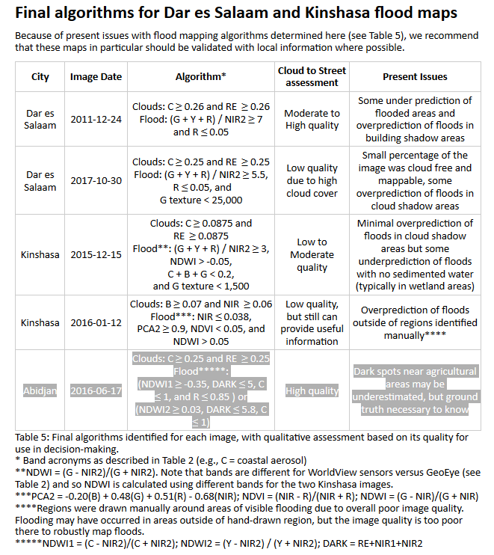
Unique algorithms for each image

Slide 40
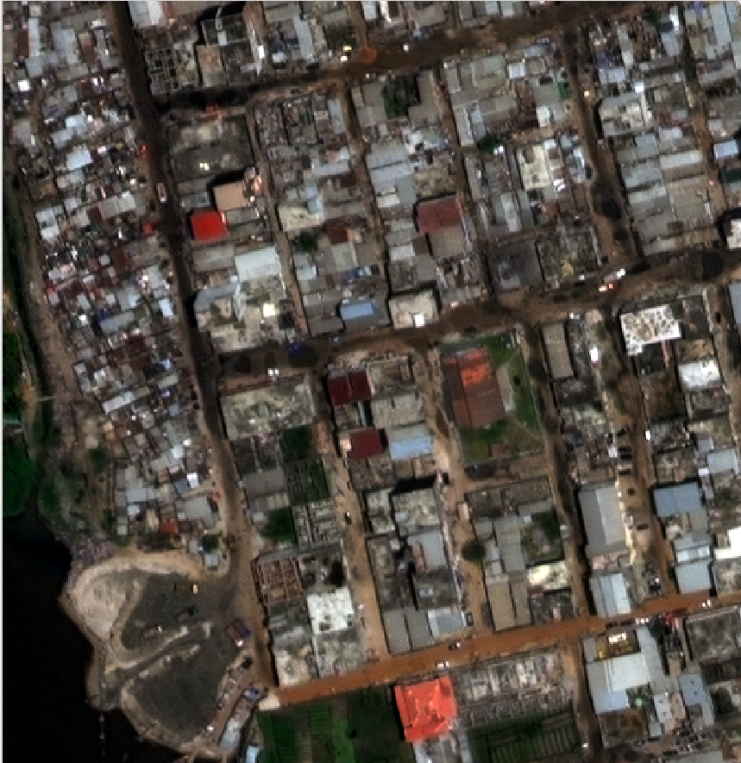
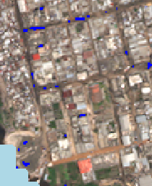
Current flood map issues
Areas of flood not captured by flood map
Building shadow misidentified as flood
WorldView-2 RGB Image
Cloud to Street Flood Map

Slide 41
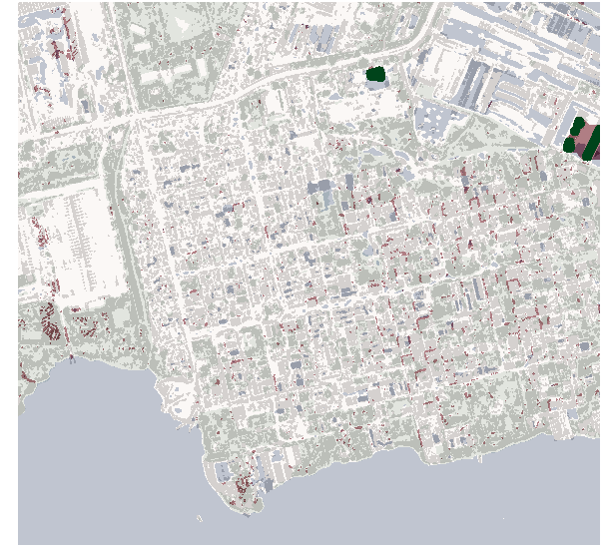
(Delete) Thresholding Result
Appears to miss substantial amount of flooding
Shadows reasonably well represented
Challenges/Next steps
Re-examine and finalize thresholds
Calculate accuracy score and confusion matrix

